Slide 2
Quan tam
1>Transact-SQL
2>Data type
3>
SELECT <select list>
Defines the columns to be returned
FROM <table source>
Defines the table to be queried
WHERE <search condition>
Filters the rows by using predicates
GROUP BY <group by list>
Arranges the rows by groups
HAVING <search condition>
Filters the groups using predicates
ORDER BY <order by list>
Sorts the output
4>IF. . .ELSE: Provides branching control based on a logical test.
WHILE: Repeats a statement or a block of statements as long as the condition is true.
BEGIN. . .END: Defines the scope of a block of Transact-SQL statements.
TRY. . . CATCH: Defines the structure for exception and error handling.
BEGIN TRANSACTION: Marks a block of statements as part of an explicit transaction.
5>+-/% predicate and operator
6>fuction,variable

Slide 3
Objectives
Explain Transact-SQL
List the different categories of Transact-SQL statements
Explain the various data types supported by Transact-SQL
Explain the Transact-SQL language elements
Explain sets and predicate logic
Describe the logical order of operators in the SELECT statement

Slide 4
Introduction
SQL is the universal language used in the database world.
Most modern RDBMS products use some type of SQL dialect as their primary query language.
SQL can be used to create or destroy objects, such as tables, on the database server and to do things with those objects, such as put data into them or query for data.
Transact-SQL is Microsoft's implementation of the standard SQL.
Usually referred to as T-SQL, this language implements a standardized way to communicate to the database.
The Transact-SQL language is an enhancement to SQL, the American National Standards Institute (ANSI) standard relational database language.
It provides a comprehensive language that supports defining tables, inserting, deleting, updating, and accessing the data in the table.
Notes:
Dialect: phương ngữ
Comprehensive: toàn diện

Slide 5
Transact-SQL 1-2
Transact-SQL is a powerful language offering features such as data types, temporary objects, and extended stored procedures.
Scrollable cursors, conditional processing, transaction control, and exception and error-handling are also some of the features which are supported by Transact-SQL.
The Transact-SQL language in SQL Server 2012 provides improved performance, increased functionality, and enhanced features.
Enhancements include scalar functions, paging, sequences, meta-data discovery, and better error handling support.
Notes:
Scalar function : hàm vô hướng

Slide 6
Transact-SQL 2-2
Following code snippet shows the Transact-SQL statement, SELECT, which is used to retrieve all records of employees with 'Design Engineer' as the JobTitle from the Employee table.
SELECT LoginID
FROM Employee
WHERE JobTitle = 'Design Engineer'
Following figure shows the result of the SELECT statement:
Transact-SQL includes many syntax elements that are used by or that influence most statements.
These elements include data types, predicates, functions, variables, expressions, control-of-flow, comments, and batch separators.
Notes:
Influence : ảnh hưởng

Slide 7
Data Definition Language (DDL)
DDL is used to define and manage all attributes and properties of a database, including row layouts, column definitions, key columns, file locations, and storage strategy.
DDL statements are used to build and modify the structure of tables and other objects such as views, triggers, stored procedures, and so on.
For each object, there are usually CREATE, ALTER, and DROP statements (such as, CREATE TABLE, ALTER TABLE, and DROP TABLE).
Most DDL statements take the following form:
CREATE object_name
ALTER object_name
DROP object_name
In DDL statements, object_name can be a table, view, trigger, stored procedure, and so on.

Slide 8
Data Manipulation Language (DML)
DML is used to select, insert, update, or delete data in the objects defined with DDL.
All database users can use these commands during the routine operations on a database.
The different DML statements are as follows:
SELECT statement
INSERT statement
UPDATE statement
DELETE statement

Slide 9
Data Control Language (DCL)
Data is an important part of database, so proper steps should be taken to check that no invalid user accesses the data.
DCL is used to control permissions on database objects.
Permissions are controlled by using the GRANT, REVOKE, and DENY statements.
DCL statements are also used for securing the database. The three basic DCL statements are as follows:
GRANT statement
REVOKE statement
DENY statement

Slide 10
Data Types 1-6
A data type is an attribute defining the type of data that an object can contain.
Data types must be provided for columns, parameters, variables, and functions that return data values, and stored procedures that have a return code.
Transact-SQL includes a number of base data types, such as varchar, text, and int.
All data that is stored in SQL Server must be compatible with one of the base data types.
The following objects have data types:
Columns present in tables and views
Parameters in stored procedures
Variables
Transact-SQL functions that return one or more data values of a specific data type
Stored procedures that have a return code belonging to the integer data type
Various items in SQL Server 2012 such as columns, variables, and expressions are assigned data types.

Slide 11
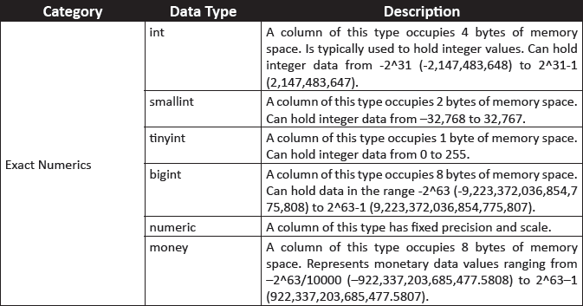
Data Types 2-6
SQL Server 2012 supports three kinds of data types:
System-defined Data Types
These data types are provided by SQL Server 2012.
Following table shows the commonly used system-defined data types of SQL Server 2012.

Slide 12
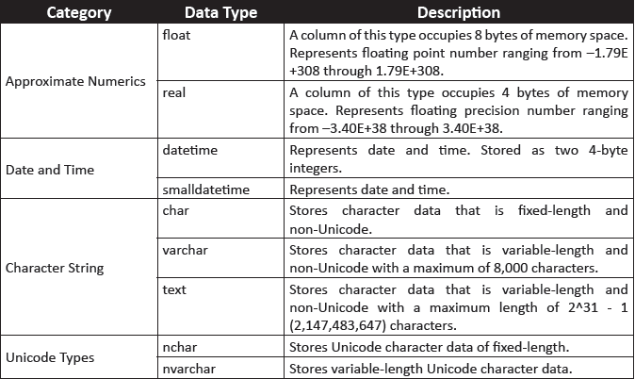
Data Types 3-6

Slide 13
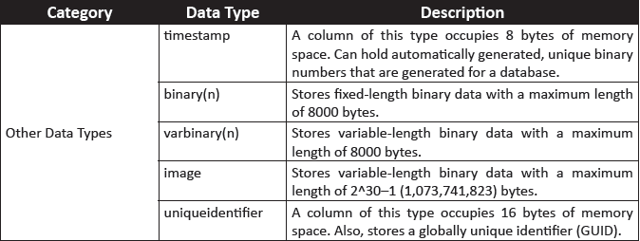
Data Types 4-6
Alias Data Types
Are based on the system-supplied data types.
Are used when more than one table stores the same type of data in a column and has similar characteristics such as length, nullability, and type.
Can be created when it can be used commonly by all these tables.

Slide 14
Data Types 5-6
Alias data types can be created using the CREATE TYPE statement.
The syntax for the CREATE TYPE statement is as follows:
Syntax:
CREATE TYPE [ schema_name. ] type_name { FROM base_type [ ( precision [ ,
scale ] ) ] [ NULL | NOT NULL ] } [ ; ]
where,
schema_name: identifies the name of the schema in which the alias data type is being created. A schema is a collection of objects such as tables, views, and so forth in a database.
type_name: identifies the name of the alias type being created.
base_type: identifies the name of the system-defined data type based on which the alias data type is being created.
precision and scale: specify the precision and scale for numeric data.
NULL | NOT NULL: specifies whether the data type can hold a null value or not.

Slide 15
Data Types 6-6
Following code snippet shows how to create an alias data type using CREATE TYPE statement.
CREATE TYPE usertype FROM varchar(20) NOT NULL
In the code, the built-in data type varchar is stored as a new data type named usertype by using the CREATE TYPE statement.
User-defined Types
Are created using programming languages supported by the .NET Framework.

Slide 16
Transact-SQL Language Elements
Are used in SQL Server 2012 for working on data that is entered in SQL Server database.
Includes the following elements:
Predicates
Operators
Variables
Expressions
Control-of Flow
Functions
Errors
Transactions
Comments
Batch Separators

Slide 17
Predicates and Operators 1-3
Predicates are used to evaluate whether an expression is TRUE, FALSE, or UNKNOWN. Some of the predicates available in Transact-SQL are as follows:
IN
Determines whether a specified value matches any value in a subquery or a list.
BETWEEN
Specifies a range of values to test.
LIKE
Used to match characters against a specified pattern.
CONTAINS
Searches for precise or less precise matches to single words and phrases, words within a certain distance of one another, or weighted matches.
Following table shows some examples of the predicates:
^{Predicate} | ^{Example}
IN | SELECT UserID, FirstName, LastName, Salary FROM Employee WHERE Salary IN(5000,20000);
BETWEEN | Select UserID, FirstName, LastName, Salary FROM Employee WHERE Salary BETWEEN 5000 and 20000;
LIKE | Select UserID, FirstName, LastName, Salary FROM Employee WHERE FirstName LIKE '%h%‘
CONTAINS | SELECT UserID, FirstName, LastName, Salary FROM Employee WHERE Salary CONTAINS(5000);

Slide 18
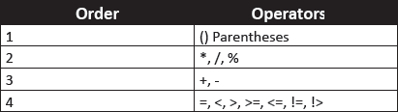
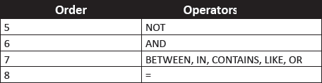
Predicates and Operators 2-3
Operators are used to perform arithmetic, comparison, concatenation, or assignment of values.
SQL Server has seven categories of operators. Following table describes the different operators supported in SQL Server 2012.
^{Operator} | ^{Description} | ^{Example}
Comparison | Compares a value against another value or an expression | =, <, >, >=, <=, !=, !>
Logical | Tests for the truth of a condition | AND, OR, NOT
Arithmetic | Performs arithmetic operations like addition, subtraction, multiplication, and division | +, -, *, /, %
Concatenation | Combines two strings into one string | +
Assignment | Assigns a value to a variable | =
Following table shows the precedence of predicates and operators:

Slide 19
Predicates and Operators 3-3
Following code snippet shows execution of operators according to precedence:
DECLARE @Number int;
SET @Number = 2 + 2 * (4 + (5 - 3))
SELECT @Number
Here, the steps to arrive at the result are as follows:
1
2 + 2 * (4 + (5 – 3))
2
2 + 2 * (4 + 2)
3
2 + 2 * 6
4
2 + 12
5
14
Hence, the code will display 14.

Slide 20
Functions 1-2
Is a set of Transact-SQL statements that is used to perform some task.
Four types of functions in SQL Server 2012 are as follows:
Rowset Functions
Aggregate Functions
Ranking Functions
Is used to return an object that can be used in place of a table reference.
Provides aggregate functions to assist with the summarization of large volumes of data.
Can implement many tasks, like creating arrays, generating sequential numbers, finding ranks, and so on in an easier and faster way by using ranking functions.
For example, OPENDATASOURCE, OPENQUERY, OPENROWSET, and OPENXML.
For example, SUM, MIN, MAX, AVG, COUNT, COUNTBIG, and so on.
For example, RANK, DENSE_RANK, NTILE, and ROW_NUMBER.
Scalar functions
Input is a single value and the output received is also a single value.

Slide 21
Functions 2-2
Following table shows the commonly used scalar functions in SQL:
^{Function} | ^{Description} | ^{Example}
Conversion function | The conversion function is used to transform a value of one data type to another. Additionally, it can be used to obtain a variety of special date formats. | CONVERT
Date and time function | Date and time functions are used to manipulate date and time values. They are useful to perform calculations based on time and dates. | GETDATE, SYSDATETIME, GETUTCDATE, DATEADD, DATEDIFF, YEAR, MONTH, DAY
Mathematical function | Mathematical functions perform algebraic operations on numeric values. | RAND, ROUND, POWER, ABS, CEILING, FLOOR
System function | SQL Server provides system functions for returning metadata or configuration settings. | HOST_ID, HOST_NAME, ISNULL
String function | String functions are used for string inputs such as char and varchar. The output can be a string or a numeric value. | SUBSTRING, LEFT, RIGHT, LEN, DATALENGTH, REPLACE, REPLICATE, UPPER, LOWER, RTRIM, LTRIM
There are also other scalar functions such as cursor functions, logical functions, metadata functions, security functions, and so on that are available in SQL Server 2012.

Slide 22
Variables
A variable is an object that can hold a data value. In Transact-SQL, variables can be classified into local and global variables.
In Transact-SQL, local variables are created and used for temporary storage while SQL statements are executed.
Data can be passed to SQL statements using local variables. The name of a local variable must be prefixed with '@' sign.
Global variables are in-built variables that are defined and maintained by the system. Global variables in SQL Server are prefixed with two '@' signs.
The value of any of these variables can be retrieved with a simple SELECT query.

Slide 23
Expressions 1-2
An expression is a combination of identifiers, values, and operators that SQL Server can evaluate in order to obtain a result.
Expressions can be used in several different places when accessing or changing data.
Following code snippet shows an expression that operates on a column to add an integer to the results of the YEAR function on a datetime column:
SELECT SalesOrderID, CustomerID, SalesPersonID, TerritoryID,YEAR(OrderDate)
AS CurrentYear, YEAR(OrderDate) + 1 AS NextYear
FROM Sales.SalesOrderHeader

Slide 24
Expressions 2-2
Following figure shows the results of the expression:

Slide 25
Control-of-Flow, Errors, and Transactions
Although Transact-SQL is primarily a data retrieval language, it supports control-of-flow statements for executing and finding errors.
Control-of-flow language determines the execution flow of Transact-SQL statements, statement blocks, user-defined functions, and stored procedures.
Following table shows some of the commonly used control-of-flow statements in Transact-SQL:
^{Control-of-Flow Statement} | ^{Description}
IF. . .ELSE | Provides branching control based on a logical test.
WHILE | Repeats a statement or a block of statements as long as the condition is true.
BEGIN. . .END | Defines the scope of a block of Transact-SQL statements.
TRY. . . CATCH | Defines the structure for exception and error handling.
BEGIN TRANSACTION | Marks a block of statements as part of an explicit transaction.

Slide 26
Comments 1-2
Comments are descriptive text strings, also known as remarks, in program code that will be ignored by the compiler.
Comments can be included inside the source code of a single statement, a batch, or a stored procedure.
Comments explain the purpose of the program, special execution conditions, and provide revision history information.
Microsoft SQL Server supports two types of commenting styles:
- - (double hyphens)
A complete line of code or a part of a code can be marked as a comment, if two hyphens (- -) are placed at the beginning.
The remainder of the line becomes a comment.
Following code snippet displays the use of this style of comment:
USE AdventureWorks2012
-- HumanResources.Employee table contains the details of an employee.
-- This statement retrieves all the rows of the table
-- HumanResources.Employee.
SELECT * FROM HumanResources.Employee

Slide 27
Comments 2-2
/* … */ (forward slash-asterisk character pairs)
These comment characters can be used on the same line as code to be executed, on lines by themselves, or even within executable code.
Everything in the line beginning from the open comment pair (/*) to the close comment pair (*/) is considered part of the comment.
For a multiple-line comment, the open-comment character pair (/*) must begin the comment, and the close-comment character pair (*/) must end the comment.
Following code snippet displays the use of this style of comment:
USE AdventureWorks2012
/* HumanResources.Employee table contains the details of an employee.
This statement retrieves all the rows of the table
HumanResources.Employee. */
SELECT * FROM HumanResources.Employee

Slide 28
Batch Separators
A batch is a collection of one or more Transact-SQL statements sent at one time from an application to SQL Server for execution.
The Transact-SQL statements in a batch are compiled into a single executable unit, called an execution plan.
The statements in the execution plan are then executed one at a time.
The process wherein a set of commands are processed one at a time from a batch of commands is called batch processing.
A batch separator is handled by SQL Server client tools such as SSMS to execute commands. For example, you need to specify GO as a batch separator in SSMS.
An example of a batch statement is given in the following code snippet:
USE AdventureWorks2012
SELECT * FROM HumanResources.Employee
GO
Here, the two statements will be grouped into one execution plan but executed one statement at a time.
The GO keyword signals the end of a batch.

Slide 29
Set Theory
Set theory is a mathematical foundation used in relational database model.
A set is a collection of distinct objects considered as a whole.
For example, all the employees under an Employee table can be considered as one set.
Following table shows the different applications in the set theory and their corresponding application in SQL Server queries.
^{Set Theory Applications} | Application in SQL Server Queries
Act on the whole set at once. | Query the whole table at once.
Use declarative, set-based processing. | Use attributes in SQL Server to retrieve specific data.
Elements in the set must be unique. | Define unique keys in the table.
No sorting instructions. | The results of querying are not retrieved in any order.

Slide 30
Predicate Logic
Predicate logic is a mathematical framework that consists of logical tests that gives a result. The results are always displayed as either true or false.
In Transact-SQL, expressions such as WHERE and CASE expressions are based on predicate logic.
Predicate logic is also used in other situations in Transact-SQL. Some of the applications of predicate logic in Transact-SQL are as follows:
Enforcing data integrity using the CHECK constraint
Control-of-flow using the IF statement
Joining tables using the ON filter
Defining subqueries
Filtering data in queries using the WHERE and HAVING clause
Providing conditional logic to CASE expressions

Slide 31
Logical Order of Operators in SELECT Statement 1-5
Along with the syntax of different SQL Server elements, an SQL Server user must also know the process of how the entire query is executed.
This process is a logical process that breaks the query and executes the query according to a predefined sequence in SQL Server 2012.
The SELECT statement is a query that will be used to explain the logical process of query execution.
The syntax of the SELECT statement is as follows:
Syntax:
SELECT <select list>
FROM <table source>
WHERE <search condition>
GROUP BY <group by list>
HAVING <search condition>
ORDER BY <order by list>

Slide 32
Logical Order of Operators in SELECT Statement 2-5
Following table explains the elements of the SELECT statement:
^{Element} | ^{Description}
SELECT <select list> | Defines the columns to be returned
FROM <table source> | Defines the table to be queried
WHERE <search condition> | Filters the rows by using predicates
GROUP BY <group by list> | Arranges the rows by groups
HAVING <search condition> | Filters the groups using predicates
ORDER BY <order by list> | Sorts the output
Following code snippet shows a SELECT statement:
SELECT SalesPersonID, YEAR(OrderDate) AS OrderYear
FROM Sales.SalesOrderHeader
WHERE CustomerID = 30084
GROUP BY SalesPersonID, YEAR(OrderDate)
HAVING COUNT(*) > 1
ORDER BY SalesPersonID, OrderYear;

Slide 33
Logical Order of Operators in SELECT Statement 3-5
In the example, the order in which SQL Server will execute the SELECT statement is as follows:
1
First, the FROM clause is evaluated to define the source table that will be queried.
2
Next, the WHERE clause is evaluated to filter the rows in the source table.
3
After this, the GROUP BY clause is evaluated.
4
Next, the HAVING clause is evaluated based on the predicate that is provided.
This filtering is defined by the predicate mentioned in the WHERE clause.
This clause arranges the filtered values received from the WHERE clause.
5
Next, the SELECT clause is executed to determine the columns that will appear in the query results.
6
Finally, the ORDER BY statement is evaluated to display the output.

Slide 34
Logical Order of Operators in SELECT Statement 4-5
The order of execution for the SELECT statement in the code snippet would be as follows:
5
SELECT SalesPersonID, YEAR(OrderDate) AS OrderYear
1
FROM SalesOrderHeader
2
WHERE CustomerID = 30084
3
GROUP BY SalesPersonID, YEAR(OrderDate)
4
HAVING COUNT(*) > 1
6
ORDER BY SalesPersonID, OrderYear;

Slide 35
Logical Order of Operators in SELECT Statement 5-5
Following figure shows the result of the SELECT statement:

Slide 36
Summary
Transact-SQL is a powerful language which offers features like data types, temporary objects, and extended stored procedures.
SQL Server supports three types of Transact-SQL statements, namely, DDL, DML, and DCL.
A data type is an attribute defining the type of data that an object can contain.
The Transact-SQL language elements includes predicates, operators, functions, variables, expressions, control-of-flow, errors, and transactions, comments, and batch separators.
Sets and Predicate Logic are the two mathematical fundamentals that are used in SQL Server 2012.
Set theory is a mathematical foundation used in relational database model, where a set is a collection of distinct objects considered as a whole.
Predicate logic is a mathematical framework that consists of logical tests that gives a result.

